Slide 1

The Battle of Neighborhood
Syed Sadaqat Ali

Slide 2
Introduction
New York City is one of the most ethnically diverse cities in the world. It started accepting immigrants in 19th century and have since became a melting pot of the diverse languages, people and cultures. In 2019, it was estimated to have a population of 8.3 million which live in 5 main boroughs namely Brooklyn, Bronx, Manhattan, Queens and Staten Island.
New York is a very busy city, both in terms of its population and tourists. As per the data of 2019, the populations of Asians American is more than a million , which is about 12 % of the population of New York city. Add to it the people from subcontinent i.e. India, Bangladesh and Pakistan, Srilanka and Nepal and you have a very large Asian and south east Asian population that has come to New York for studying, jobs and businesses.

Slide 3
Business Problem Description
An entrepreneur has recently moved to New York's and is looking to open a restaurant in Manhattan. His initial market research reveals that there is good opportunity for a Thai food restaurant as it equally popular among the European and north American tourists who crave exotic food and will pay hefty prices for a upbeat expensive restaurant that provides good ambiance and Asian population who loves aromatic and spicy food at affordable prices. Manhattan is also very diverse in terms of earning and the entrepreneur is thus planning to open two Thai restaurants, an expensive version providing a fine dinning experience to wealthy residents and tourists and an express version for middle class clients.
The business man thus hires a data science firm to suggest to him the location for two restaurants, the upbeat expensive restaurant in an locality which offers the opportunity for less competition for Thai food at affordable prices in a neighbourhood which has low number of Thai food restaurants.

Slide 4
Target Audience
A entrepreneur who wants to open a Thai Restaurant in Manhattan,New York.

Slide 5
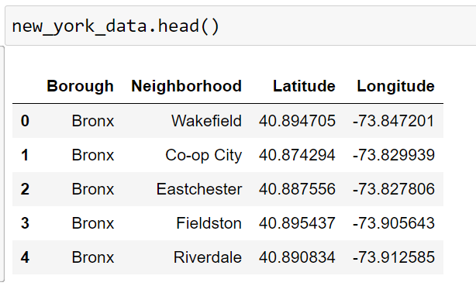
Data Sources
Geospatial data of the boroughs
New York population is distributed into 5 boroughs and 306 neighbourhoods. To explore the data, we need to get the access to the data containing the boroughs and their geospatial coordinates. I downloaded the data freely available from the website
https://cocl.us/new_york_dataset
in geojason format. This data will be transformed into Pandas data frame for easy data analysis and visualization.

Slide 6
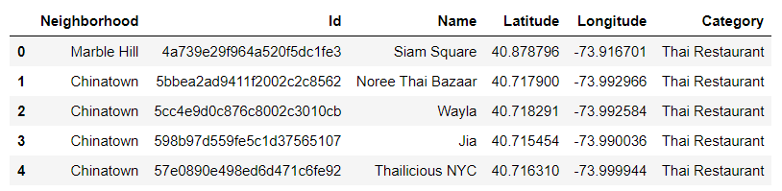
Data Sources (Continued)
Additionally from FourSquare API , we get Neighborhood names, ID, restaurant names, lat/long and restaurant categories.
The data was retrieved from Foursquare API that required a user account and the secret key and Client ID which allows to extract required data from Foursquare API

Slide 7
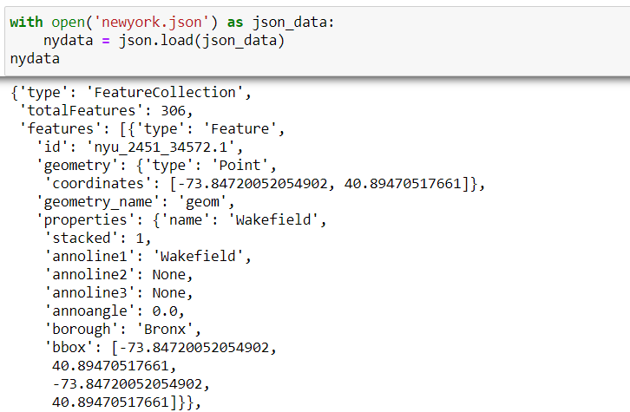
Methodology – Data Retrieval
Data was retrieved from
https://cocl.us/new_york_dataset
The data is automatically downloaded to a file called “nyu_2451_34572-geojason.json”. The file was renamed to newyork.Jason for easy referral.

Slide 8
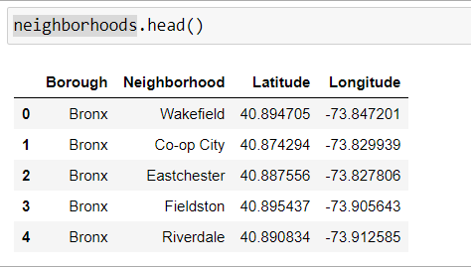
Methodology – Data Transformation
Data was transformed from .json format to pandas dataframe called “neighborhoods”

Slide 9
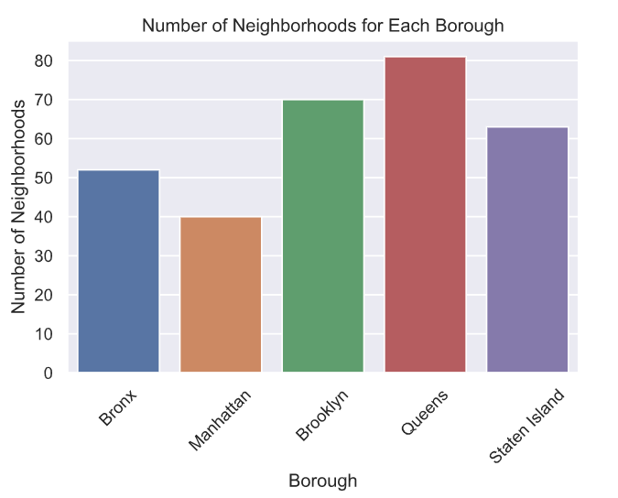
Methodology – Data Visualization
The transformed data was then plotted as bar plot using Seaborn plotting library. Boroughs were plotted against the neighborhoods to get a feel neighborhood distribution per burough

Slide 10
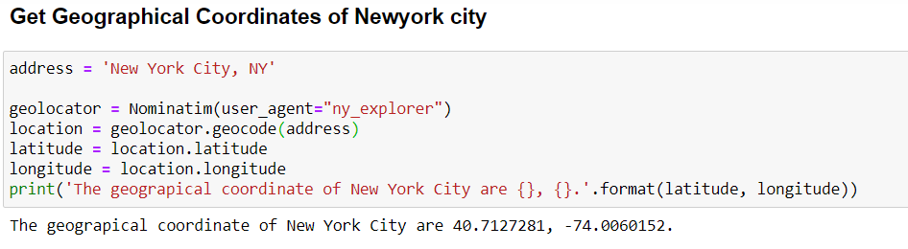
Methodology – Geocoder Locations
Geopy package helps to retrieve the location data from any selected area such as neighborhood or borrows

Slide 11
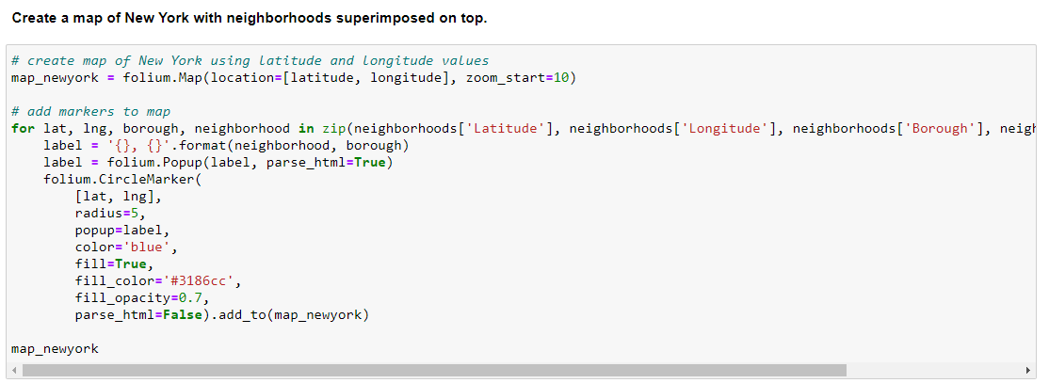
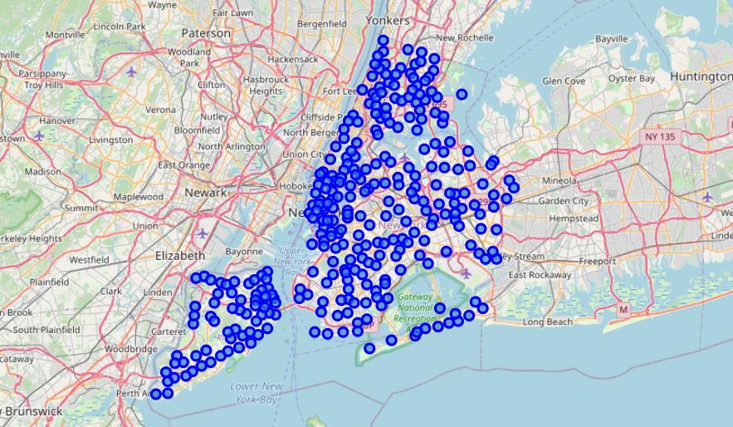
Methodology – Visualize Regional Geospatial Data
(Newyork)
Folium library was used to create the map of Newyork and its neighborhoods

Slide 12
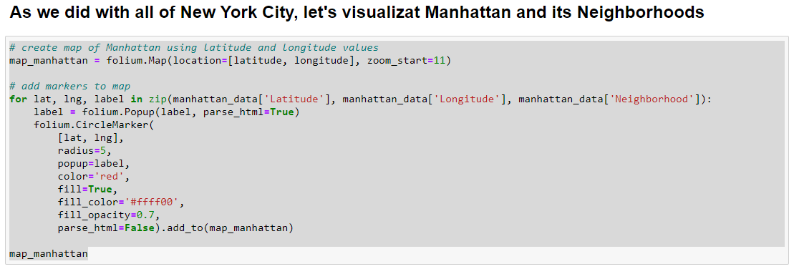
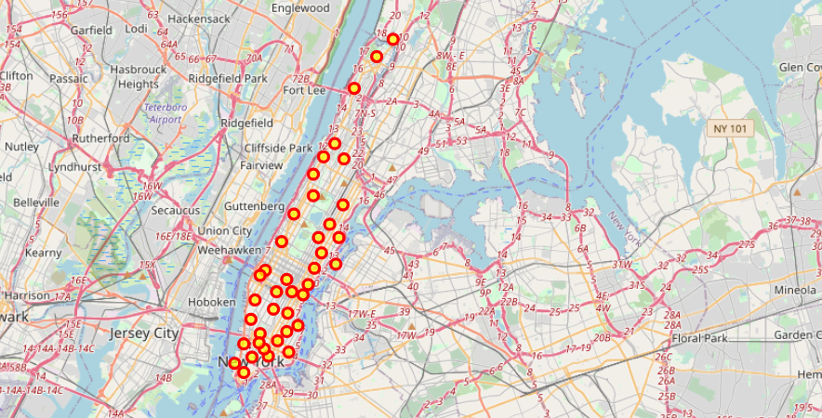
Methodology – Visualize Local Geospatial Data
(Manhattan)

Slide 13
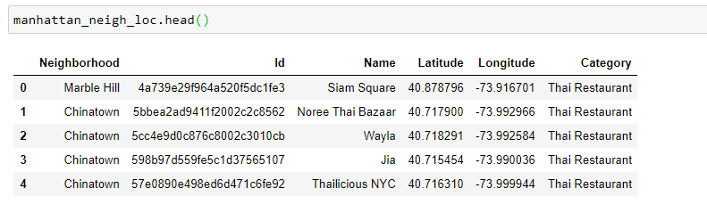
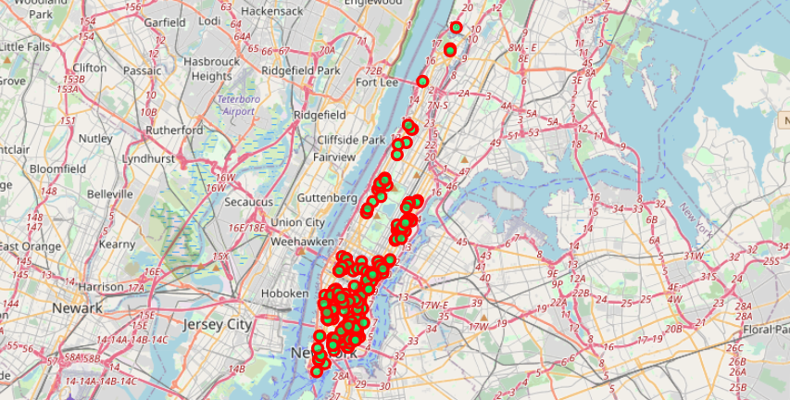
Methodology – Explore the Neighborhood
Data exploration of the neighborhood of the nearby venues of Manhattan was done and data was filtered based on Thai restaurants and data was plotted on the map for the neighborhoods with thai restaurants

Slide 14
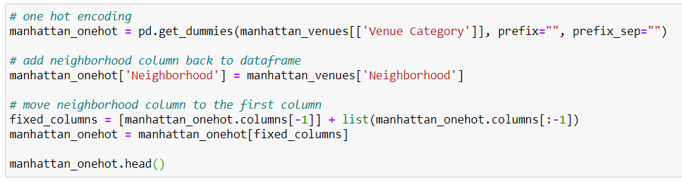
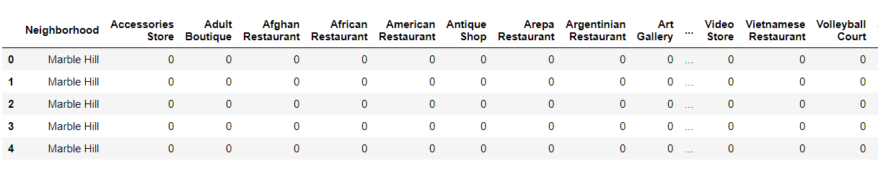
Methodology – Data Preparation for Machine Learning
Machine learning cannot be applied to the categorical data; thus the data needs to be transformed into numerical data using different technique. One such technique is called One Hot Encoding which helped convert the venues occurrence to frequency and how many venues were in each neighborhood

Slide 15
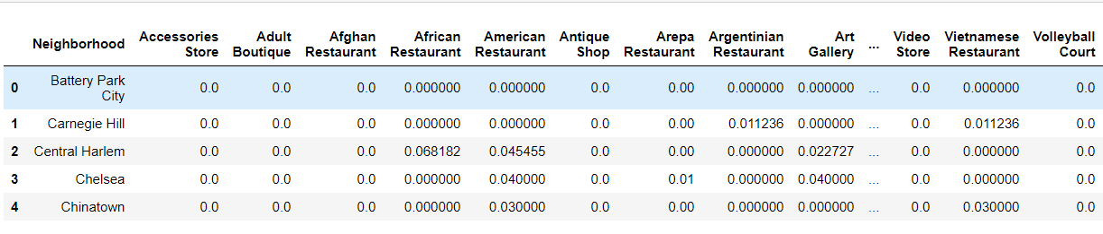
Methodology – Kmeans Clustering
Kmeans clustering is an unsupervised machine learning algorithms that groups together a set of objects in a way that objects in the same cluster are more similar to each other than to objects in other clusters. Kmeans clustering was used to cluster the neighborhoods that has similar averages for Thai restaurants in that particular neighborhood

Slide 16
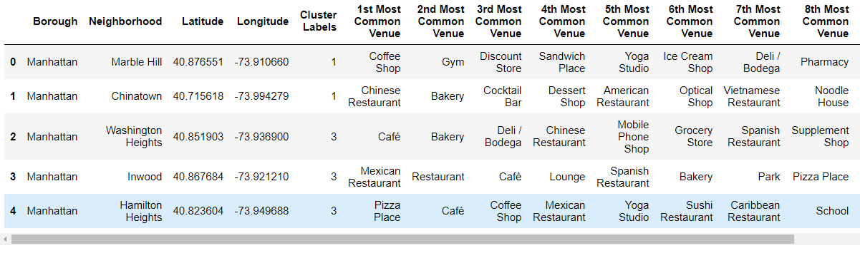
Methodology – Merged Dataframe with Venues and Clusters
We then created a new dataframe that includes the cluster as well as the top 10 venues for each neighborhood.

Slide 17
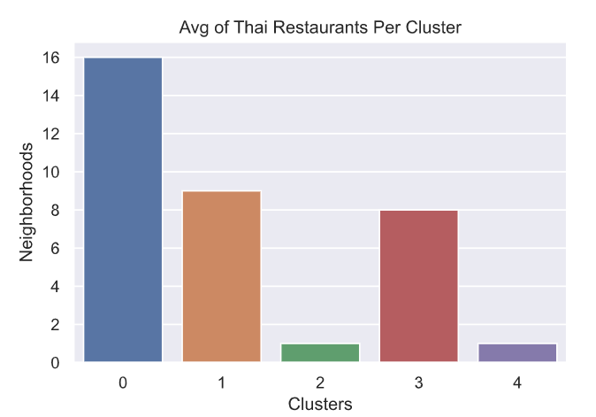
Methodology – Cluster Visualization
The resulting clusters were then visualized as bar plot using seaborn library to show average number of Thai resturants in each cluster within Manhattan. We can see that most of the Thai restaurants are in cluster 0. Interpreting the plot, we can see that the most optimum cluster to open the thai restaurant are cluster number 2 or number 4. As per initial requirement, the entrepreneur needed to invest safely in an area with less competition.

Slide 18
Results
Datascience methodology proved effective in recommending areas for opening a Thai Resturant with high probability of good return on investment.
The exercise showed how data can be scraped from a website and used in python environment for data analysis, visualization and applying machine learning
Data visualization provided excellent methods of graphically representing the data and using seaborn library and geospatial data was effectively visualized using the folium library.
Kmeans provided good clustering algorithm for helping to recommend a location for thai Resturant that makes business sense.

Slide 19
Discussion
There is room for the improvement as other features such as restaurant ratings, areas with best tips and user likes from foursquare would provide more data and better clustering based on multi-attribute analysis and clustering.
The exercise showcased the power of datascience methodology and practice as recommender system and in visualization and data wrangling domains

Slide 20
Conclusion
The exercise provided good opportunity to help recommend a best place / places for opening a restaurant in Manhattan, Newyork. This methodology can be applied to variety of similar problems requiring clustering and recommendations using unsupervised machine learning.
We were able to predict the best location to start Thai resturant while ensuring the high rate of return and safe investment.

Slide 21
END
Syed Sadaqat Ali

